Slide 1

SUPPLY CHAIN PROJECT
By…
Group-3

Slide 2

Agenda
Summary
Data Flow
Data Modelling
KPI list
Excel Dashboard
Tableau Dashboard
Power BI Dashboard
Key Insights
Key Takeaways

Slide 3
Summary
Leveraged data analysis and visualization to unlock valuable insights in the dynamic Manufacturing industry.
Utilized Excel, Tableau and Power BI to create interactive dashboards addressing specific business needs.
Use data to target marketing, inform product development, and measure performance. Implement dynamic pricing, identify new product opportunities, and recommend relevant products..
Optimize production, manage inventory, and predict maintenance with data. Personalize products, gather quality feedback, and predict customer needs. .

Slide 4





Data Flow
Calendar
Provides information about dates, including fiscal year, season, quarter, period, week, and day of the year.
Customer
Stores customer information, including age group, civil status, address, age, city, country, gender, loyalty program details, region, state, ZIP code, and loyalty tier.
County
Provides data on counties in the United States, including county code, county name, and state code.
Product
Holds product information, including product key, product name, type, family, line, group, description, SKU number, price, cost amount, and quantity on hand.
Store
Contains information about various stores, including store key, store name, store region, store state, store city, latitude, and longitude.

Slide 5




Data Flow
Inventory Adjusted
Contains data related to adjusted inventory, including product key, product name, type, family, quantity on hand, price, and cost amount.
Plugs Electronics
Holds data related to electronics sales, including order number, date, SKU number, quantity, cost, price, product type, product family, and store and customer information.
Point of Sales
Stores information about sales transactions, including order number, product key, sales quantity, sales amount, and cost amount.
Sales
Holds Order Number, Customer Key, Store key, Transaction Type, Date and Purchase Method.

Slide 6
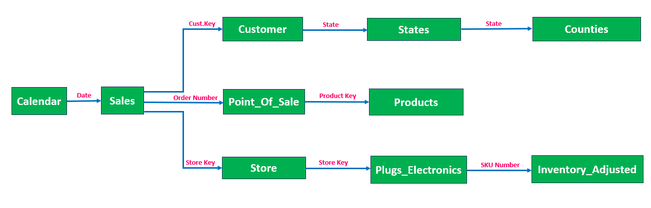
Data Modelling

Slide 7
List of KPIs
Store Wise Sales
Total Sales
Product Wise Sales
Sales Growth
Daily Sales Trend
State wise Sales
Top 5 Store Wise Sales
Total Inventory
Inventory Value
Over Stock, Out Stock, Under Stock of Inventory

Slide 8
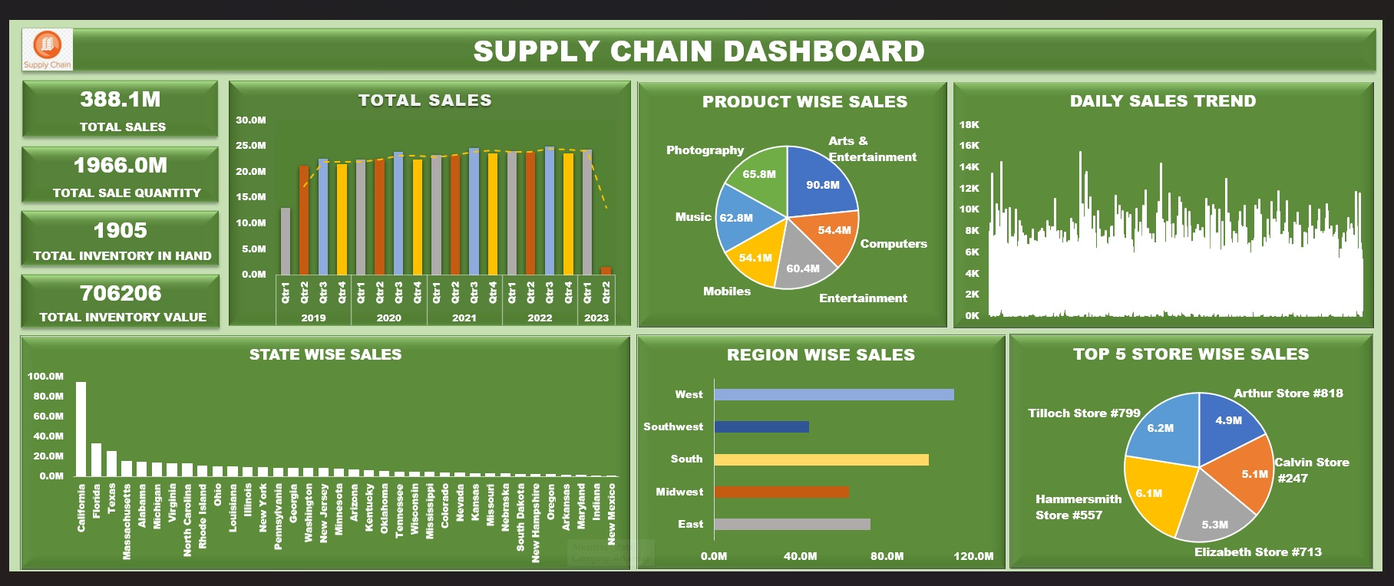
Excel Dashboard

Slide 9
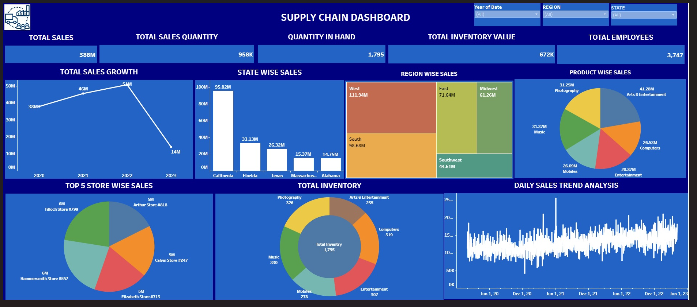
Tableau Dashboard

Slide 10
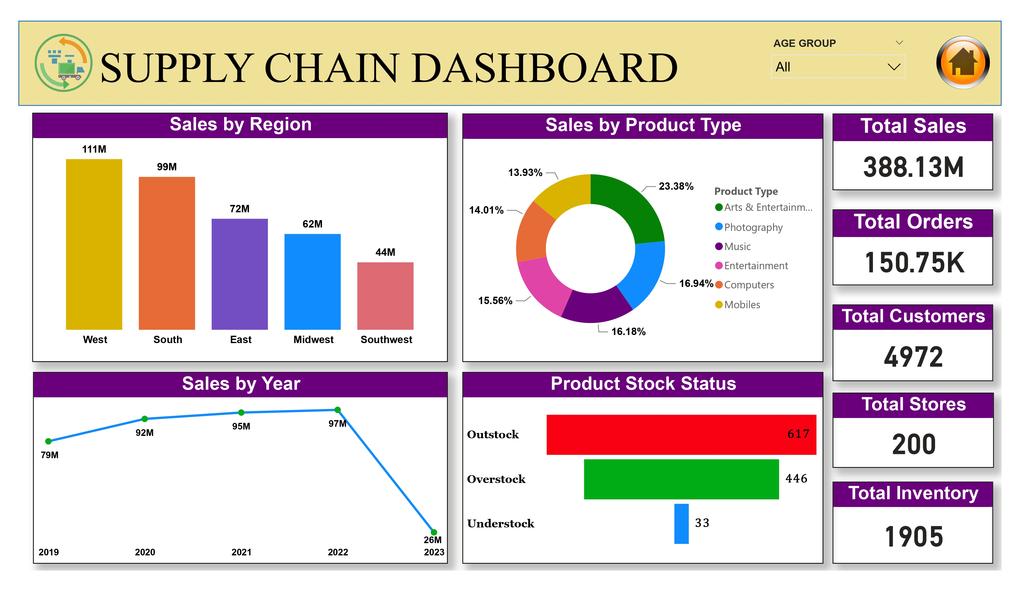
Power BI Dashboard

Slide 11
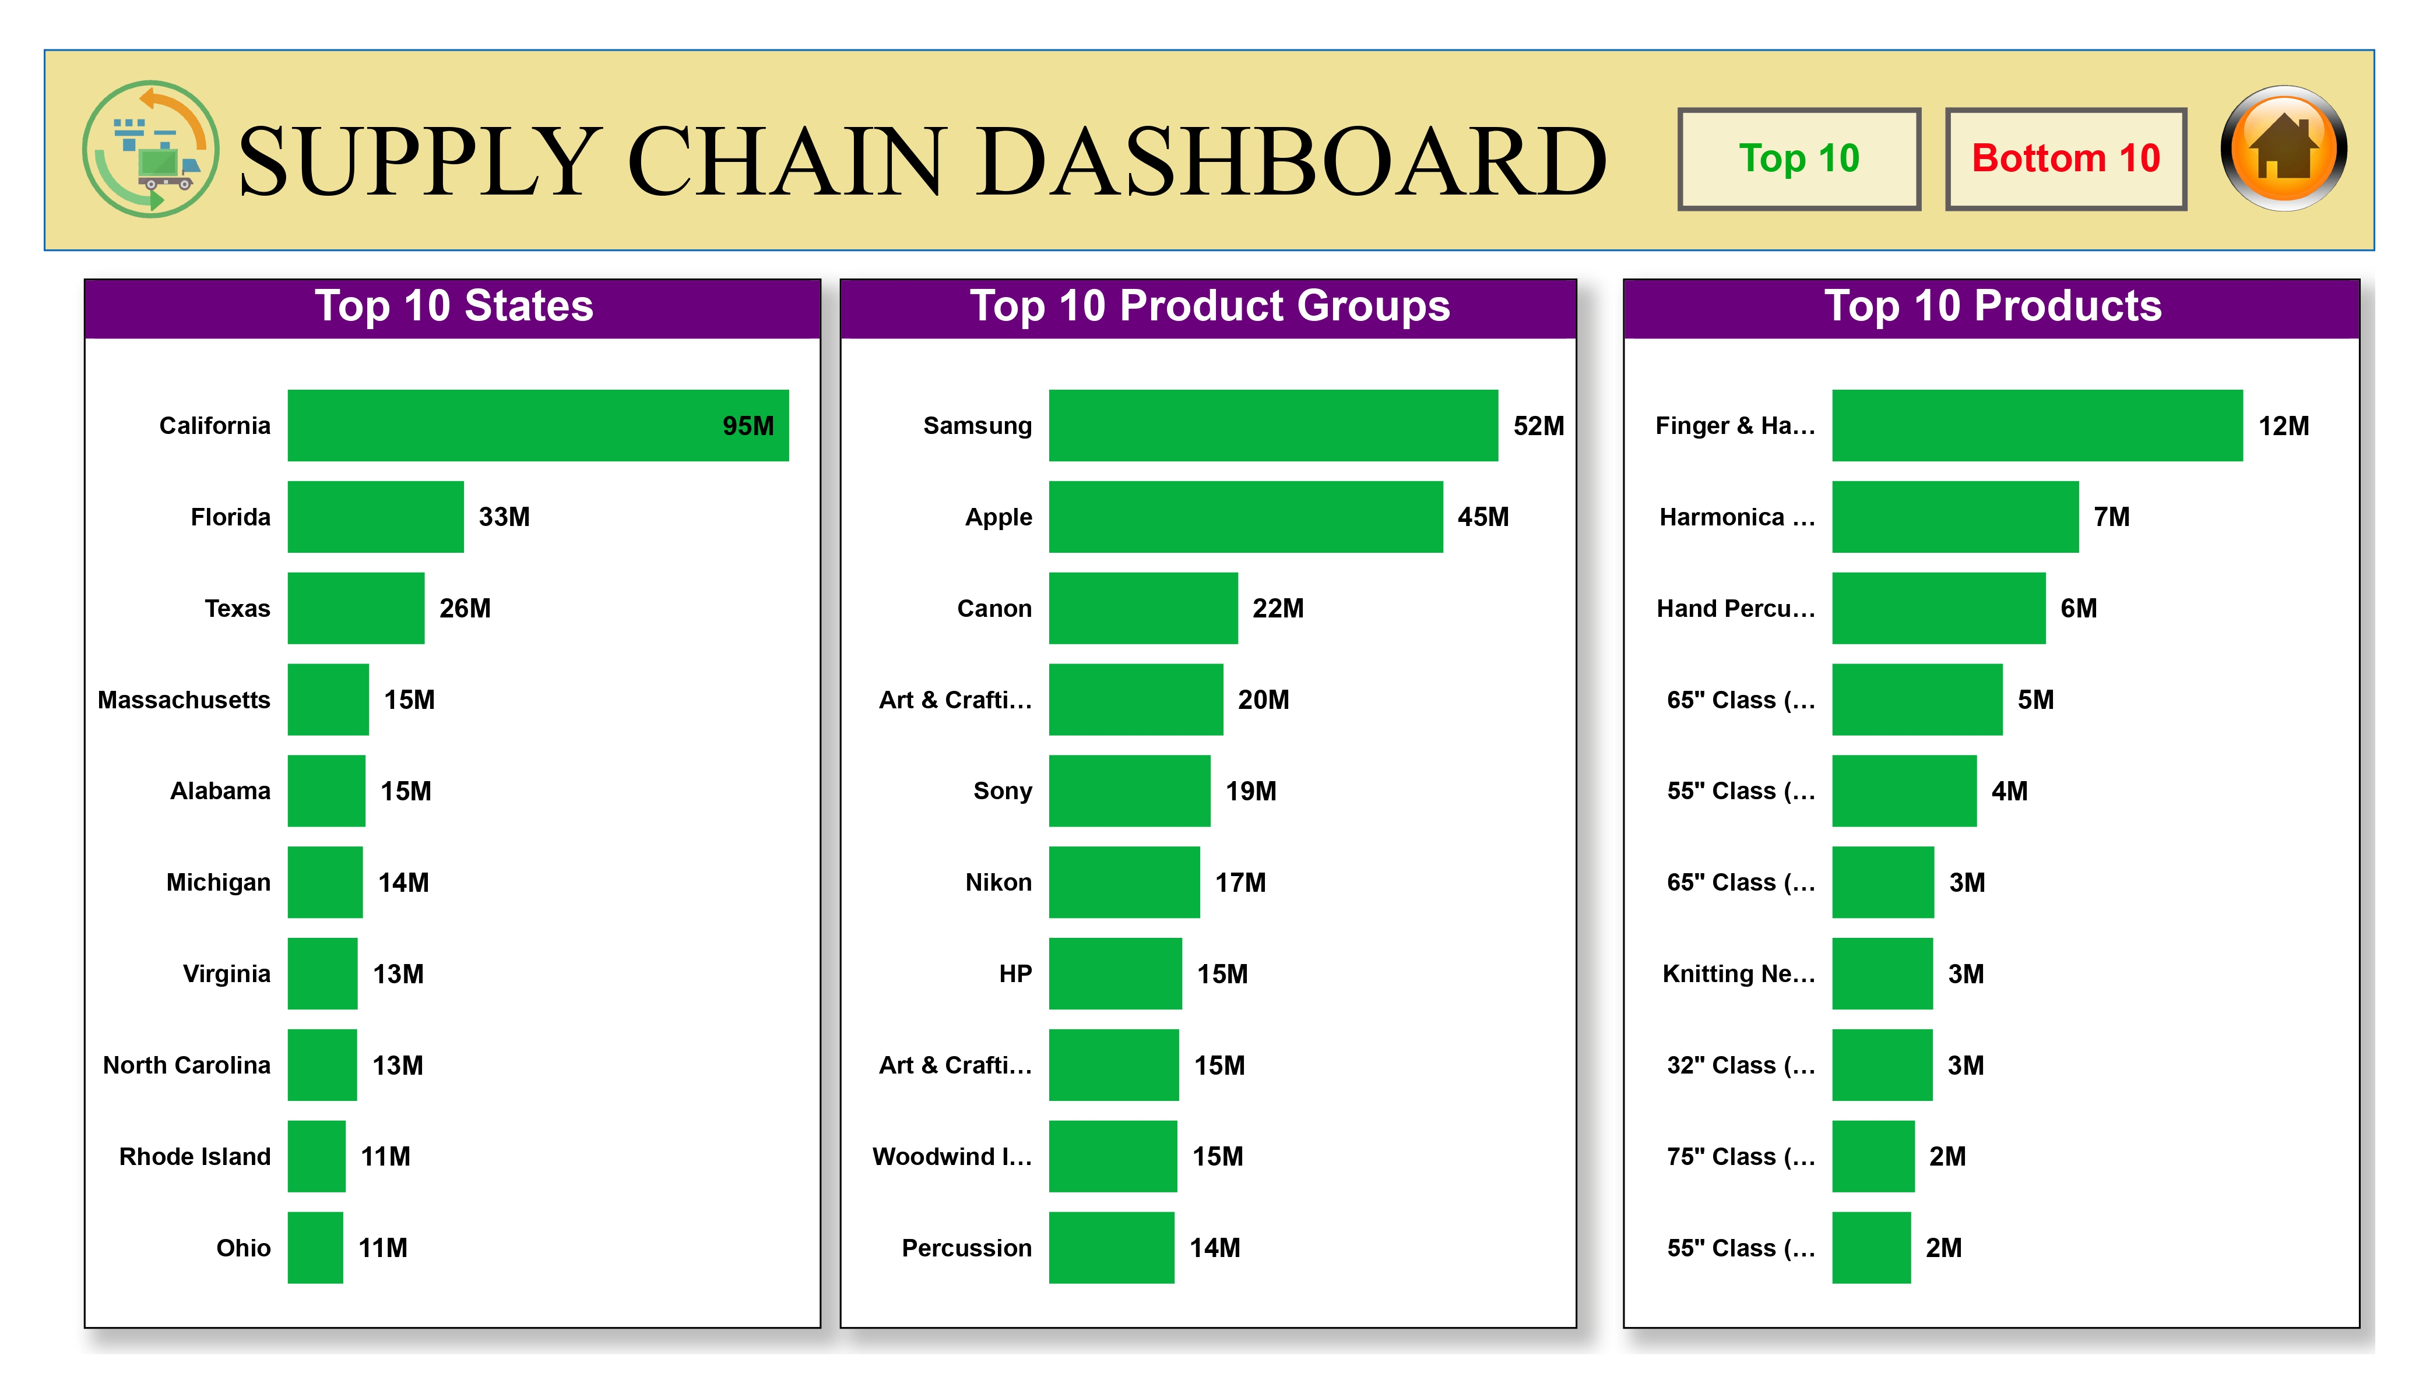

Slide 12
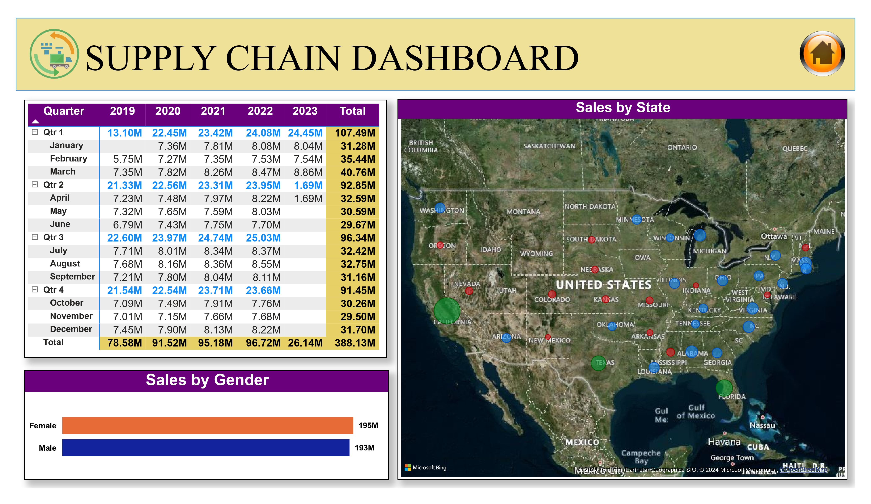

Slide 13
Key Insights
Strong Sales Growth: The Company achieved significant sales growth of $46 Million year-over-year, representing a 12% increase.
Top Performing Stores: The top 5 stores contributed 57% of total sales, with All Mart leading the pack at $111.54 million.
Inventory Management: The company maintains a diversified inventory with Arts & Entertainment, Avtar Share and Competitive Entertainment products ranking highest in Value.
Positive Sales Trends: The daily sales trend chart suggests a steady increase in sales, indicating positive momentum for the company.

Slide 14
Key Takeaways
Sustain sales Growth: Implement strategies to maintain or accelerate sales growth, such as targeted marketing campaigns or exploring new sales channels.
Prioritize top customers: Allocate resources towards marketing and relationship-building initiatives with the top 5 stores to solidify their loyalty and further increase sales.
Inventory Optimization: Regularly review and optimize inventory levels to ensure sufficient stock of high-demand products while minimizing carrying costs.
Sales Trend Monitoring: Continuously monitor sales trends and make proactive adjustments to strategies as needed to maintain positive momentum.

Slide 15


